Slide 1

Occupancy estimation using Environmental sensors
DR. B.C. ROY ENGINEERING COLLEGE
PRESENTED BY
SUMIT DHAR | 12000120073
SAPTARSHI GHOSH | 12000120068
ABHIK MANDAL | 12000120096

Slide 2
INTRODUCTION
Occupancy refers to the number of individuals present in a particular facility at any particular time, say, the number of students/teachers present in a school or the number of employees present in an office, etc.
As the degree of occupancy in a classroom can significantly affect the Indoor Air Quality (IAQ), it plays a critical role in students’ and teachers’ health, comfort, and productivity.
Long exposure to such an environment may cause various health issues, including respiratory problems, allergies, dizziness, and reduced cognitive performance.
Assessing occupancy patterns within indoor spaces is vital for optimizing energy usage, HVAC systems, and resource allocation.
“What should be the key parameters to estimate the classroom occupancy using environment monitoring sensors accurately?”

Slide 3
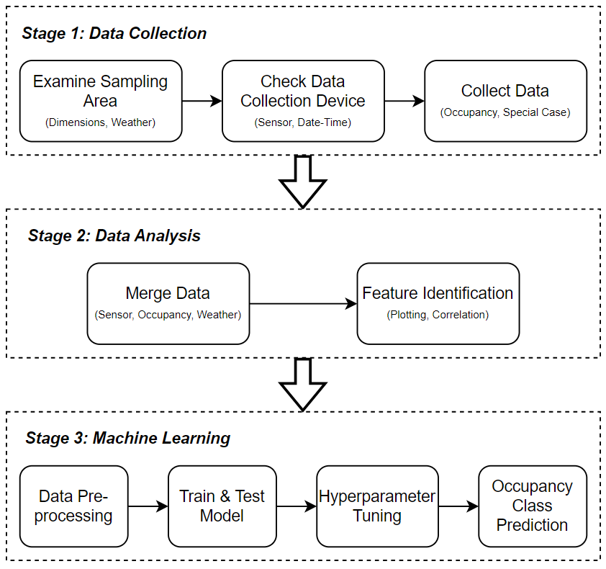
FRAMEWORK

Slide 4
ROOM PARAMETERS

Slide 5
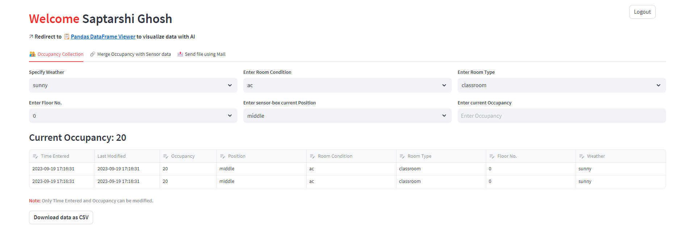

OCCUPANCY COLLECTION AND MERGING

Slide 6
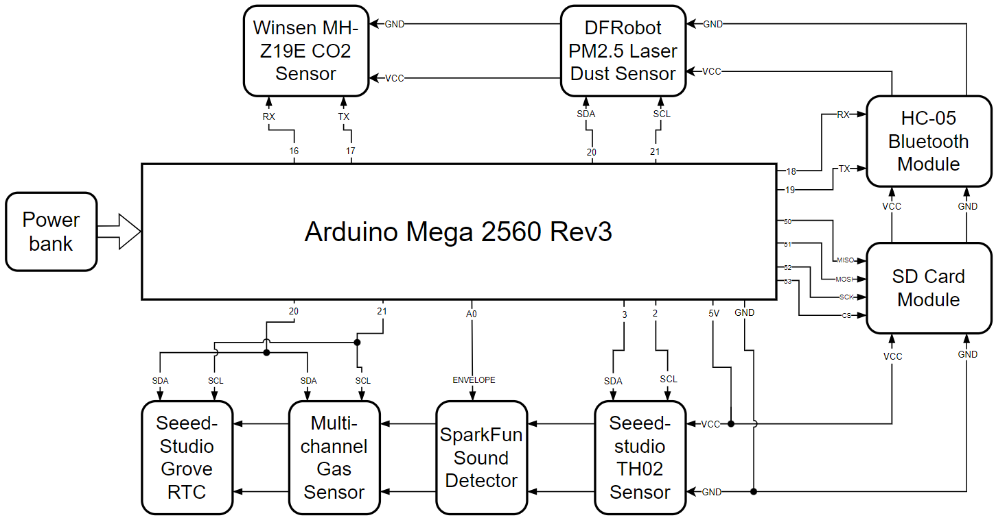
DEVICE ARCHITECTURE

Slide 7
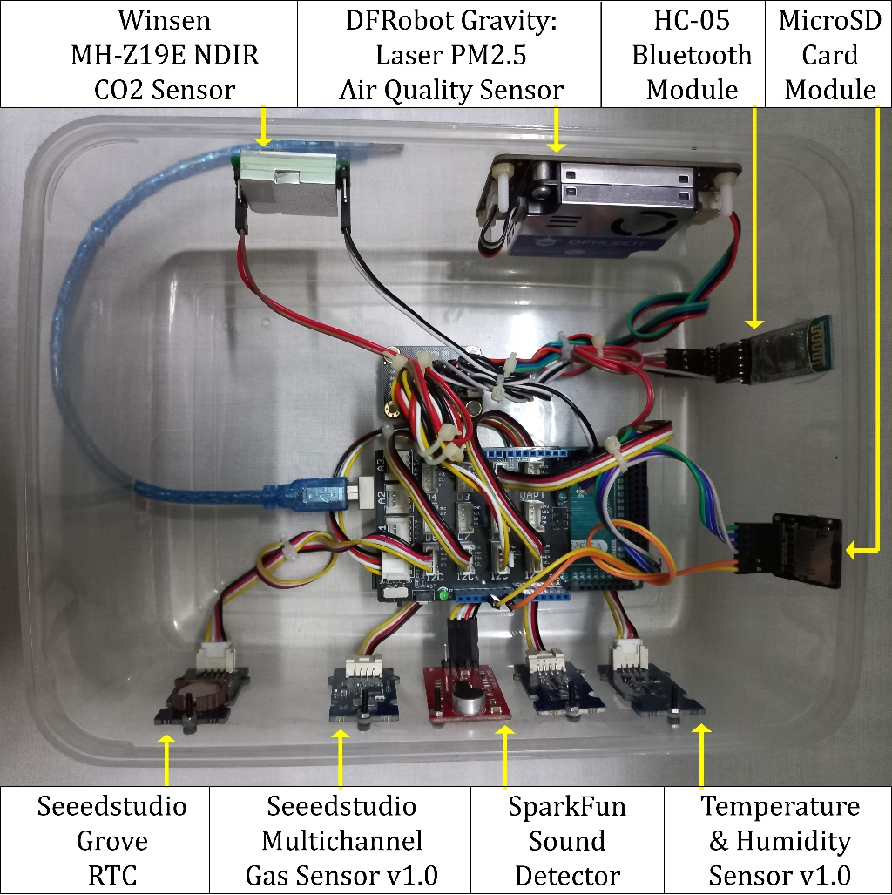
NAME | RANGE | PRICE (INR) | CALIBRATION
Arduino Mega 2560 Rev3 |  | 3100
SeeedStudio Grove RTC |  | 749
Winsen MH-Z19E NDIR CO2 Sensor | CO₂: 400-5000 ppm | 1580 | Self
DFRobot Gravity: Laser PM2.5 Air Quality Sensor | PM: 0-500 µg/m³ | 3299 | Factory
Seeedstudio Grove: Multichannel Gas Sensor v1.0 | CO: 0-1000 ppm NO₂: 0.05-10 ppm | 3600 | Factory
Seeedstudio Grove: VOC and eCO2 Gas Sensor (SGP30) | TVOC: 0-60000 ppb | 1650 | Factory
SparkFun Sound Detector | 30-130 dB | 1049
Grove: Temperature & Humidity Sensor v1.0 | T: 0-70 °C RH: 0-80 % | 2200 | Factory
HC-05 Bluetooth Module |  | 513
DFRobot Fermion: MicroSD Card Module |  | 330

Slide 8
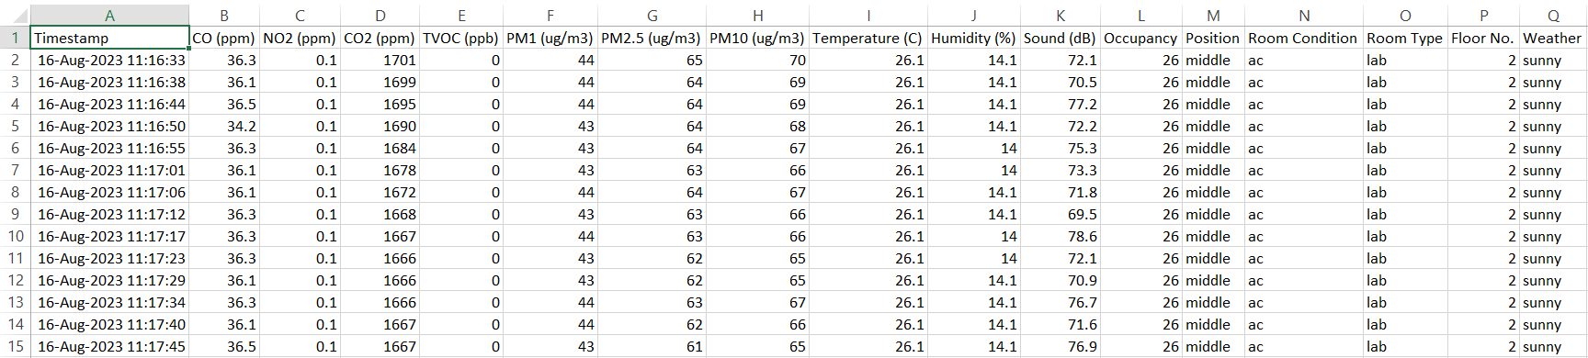
DATA ACQUISITION
Total Dataset Shape: 5869 x 17
Carbon Dioxide (CO₂)
Particulate Matter (PM₁, PM_{2.5}, PM₁₀)
Volatile Organic Compounds (TVOC)
Temperature
Humidity
Sound (dB)
Carbon Monoxide (CO)
Nitrogen Dioxide (NO₂)
Occupancy
Position
Room Type
Room Condition
Floor No.
Weather
Parameters Used:

Slide 9
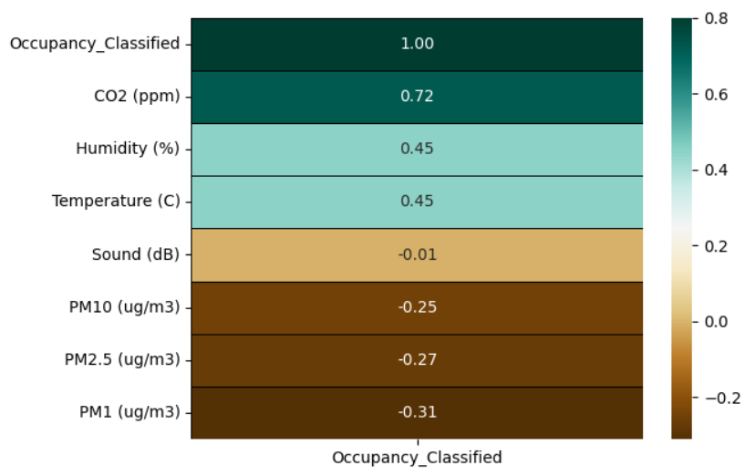
CORRELATION WITH OCC_CLASSIFIED
At first, we calculate the overall correlation between the parameters and the Classified Occupancy. We take into consideration CO2 and PM as our significant factors because of their strong positive and negative correlations with the Classified Occupancy as shown in the figure below.
Further, we note that Temperature and Humidity have a positive correlation with Classified Occupancy, whereas Sound has almost negligible correlation with the same. That is why we disqualify sound from consideration in our later studies.

Slide 10
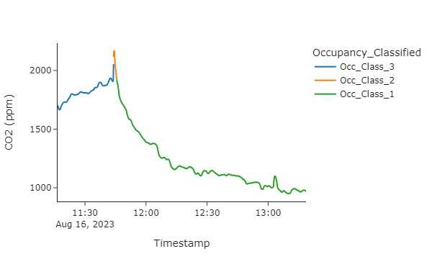
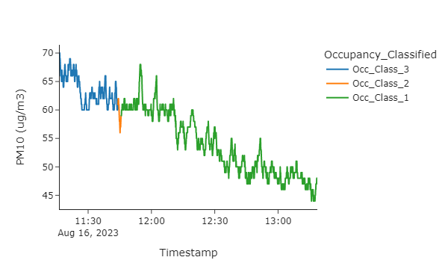
Illustration of CO2 with respect to time
Illustration of PM10 with respect to time
As we see during the beginning of the data accumulation, the laboratory has an Occupancy range within 21 − 30, and the values of PM10 and the concentration levels of CO2 are higher than the values of the same afterwards when the room has lesser Occupancy range. Soon after 11 : 40 AM, we see a sharp drop in the Occupancy in the lab, which is the reason behind the values of PM10 and CO2 declining throughout the rest of the period.
16.08.2023
Lab, AC

Slide 11
Machine learning
All the preprocessing is done on the following features:
CO2 (ppm) | PM1 (ug/m3) | PM2.5 (ug/m3) | PM10 (ug/m3) | Temperature © | Humidity (%) | Position | Floor No. | Weather | Occupancy_Classified (Target)
Mapping String attributes to Categorical Codes:
After merging all the datasets of different dates, we preprocess the data by converting all the string attributes features i.e., Position, Weather to categorical codes, i.e., mapping all data to categorical codes, the mapping is shown below:
Mapped Value | Position | Weather
0 | backside | cloudy
1 | frontside | overcast
2 | middle | rainy
3 |  | sunny
Handling Null Values:
Feature | Null Value Count
CO2 (ppm) | 459
As CO2 is a primary attribute and holds maximum correlation with the occupancy class, we cannot introduce mean or median values to the null values. So we will drop all null values.
Total Dataset Length after preprocessing: 4238 rows

Slide 12
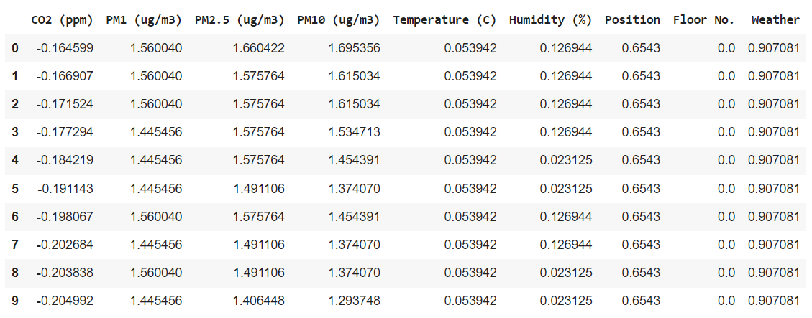
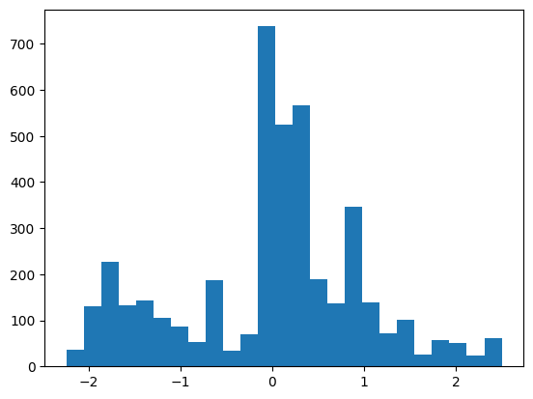
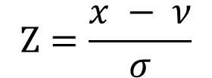

Feature Engineering:
According to the correlation plot, all the features are quite important, so we are not applying any dimensionality reduction technique, also dataset width in within the limit. Also we have introduced Position, Floor No., Weather as secondary attributes which also has a quite impact on modeling. Feature Scaling:
We have scaled all the features using Standard Scaling method, which is used to standardize the features by removing the mean and scaling it to unit variance and also it transforms the data in a normal distribution (data near the mean are more frequent in occurrence than data far from the mean).
$$Ζ=\frac{x − ν}{σ}$$
Where $ν$ = Mean, $σ$= Standard Deviance
So after all the preprocessing, we break the dataset into a 60:40 train test split ratio randomly with random seed = 42.
The preprocessed train dataset looks like‌:
Distribution of a feature after scaling
Maximum data points lies closer to mean and goes lesser when further from mean (Standardization).

Slide 13
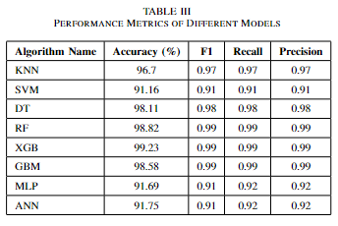
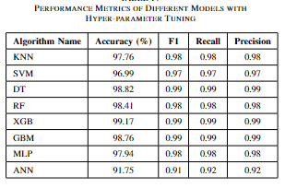
ML Models:
We have selected 8 different models namely: K Nearest Neighbor (kNN), Support Vector Machine (SVM), Decision Tree (DT), Random Forest (RF), Extreme Gradient Boosting (XGB), Gradient Boosting Machine (GBM), Multi Layer Perception (MLP), Artificial Neural Network (ANN).
First we have trained all the models with default parameters, after that we have use hyper parameters to train on the dataset. All the hyper parameters are chosen from past experience and from the internet guide.
We have applied RandomizedSearchCV and GridSearchCV with k fold cross validation where k = 5 for each of the models with iterations ranging from [10, 150] according to model complexity to tune with the hyper parameters, and the best parameters are chosen on behalf of accuracy. Then we have tested the model with the 40% test data and got the following results:

Slide 14
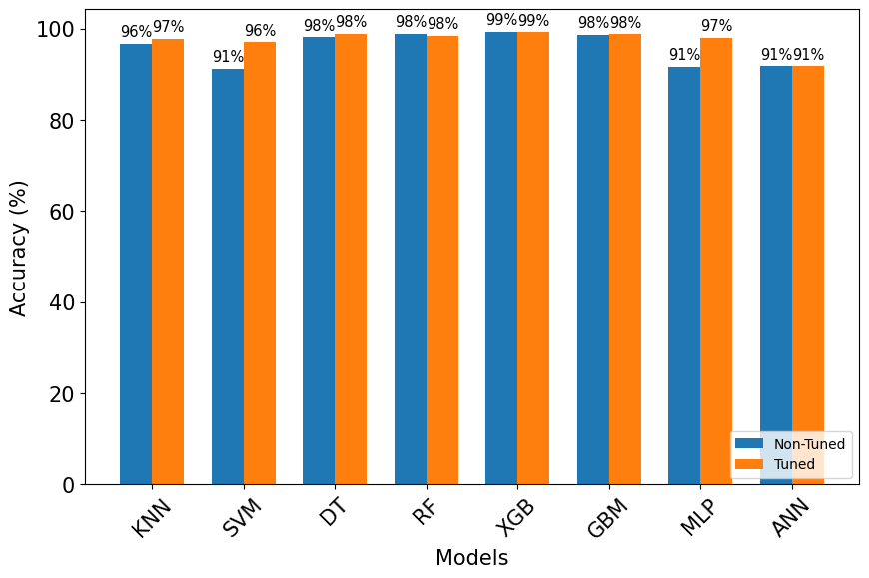
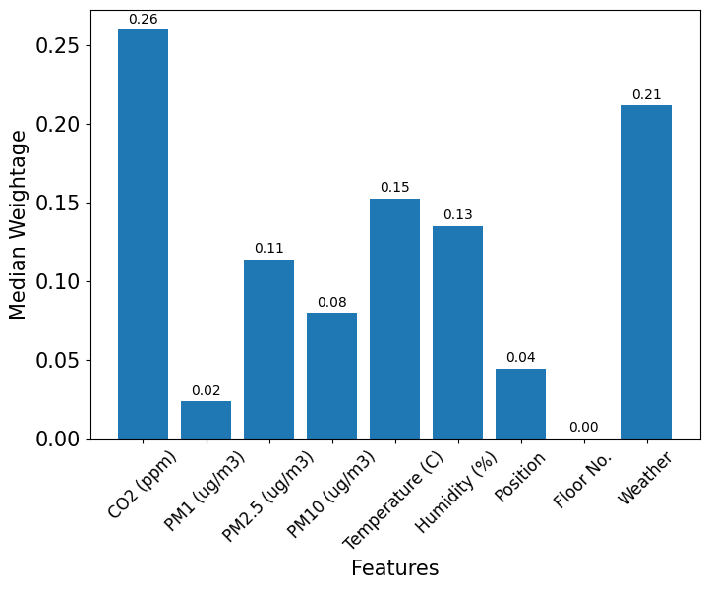
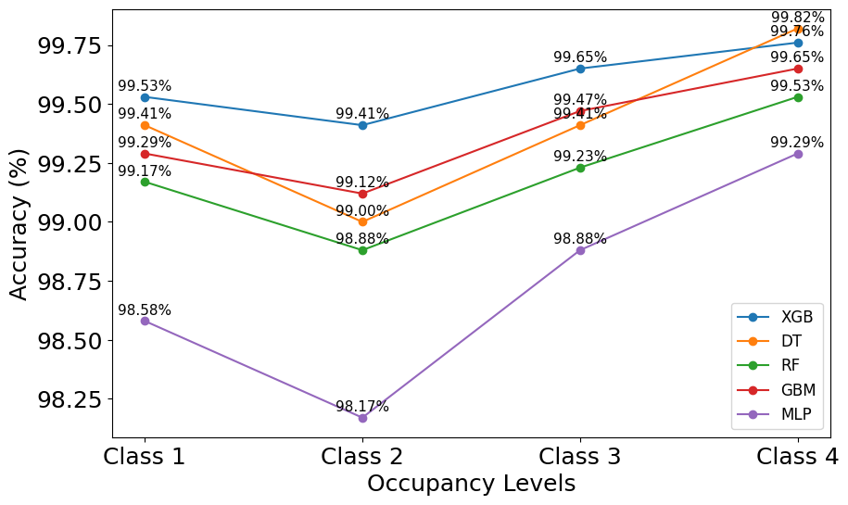
Comparison of Accuracy Scores between Non Hyper Parameter Tuning and With Hyper Parameter Tuning Models
Median Weightage Feature Importance of each model
Each Occupancy Class Accuracy Scores

Slide 15
CONCLUSION
Studying IAQ variability and assessing occupancy using heterogeneous data is crucial for creating healthier, more efficient indoor environments.
The integration of diverse data sources allows us to gain comprehensive insights into IAQ dynamics and their relation to occupancy patterns.
The findings of this study have the potential to revolutionize indoor space management and contribute to occupant well-being and sustainability.
CO2, PM, Temperature and Humidity could be important features in predicting Occupancy.
Predicting Occupancy for Classroom with Non-AC type for Ground Level can be bit challenging.

Slide 16
REFERENCES
Zawar Hussain, Quan Z Sheng, and Wei Emma Zhang. A review and categorization of techniques on device-free human activity recognition. Journal of Network and Computer Applications, 167:102738, 2020.
Arindam Ghosh, Amartya Chakraborty, Dhruv Chakraborty, Mousumi Saha, and Sujoy Saha. Ultrasense: A non-intrusive approach for human activity identification using heterogeneous ultrasonic sensor grid for smart home environment. Journal of Ambient Intelligence and Humanized Computing, pages 1–22, 2019.
Kangwei Li, Jiandong Shen, Xin Zhang, Linghong Chen, Stephen White, Mingming Yan, Lixia Han, Wen Yang, Xinhua Wang, and Merched Azzi. Variations and characteristics of particulate matter, black carbon and volatile organic compounds in primary school classrooms. Journal of Cleaner Production, 252:119804, 2020.
Lavinia Chiara Tagliabue, Fulvio Re Cecconi, Stefano Rinaldi, and Angelo Luigi Camillo Ciribini. Data driven indoor air quality prediction in educational facilities based on iot network. Energy and Buildings, 236:110782, 2021.
Arindam Ghosh, Prithviraj Pramanik, Kartick Das Banerjee, Ashutosh Roy, Subrata Nandi, and Sujoy Saha. Analyzing correlation between air and noise pollution with influence on air quality prediction. In 2018 IEEE International Conference on Data Mining Workshops (ICDMW), pages 913–918. IEEE, 2018.

Slide 17
PAPER PUBLICATION
Title: OccuCon: A Context-aware Environment Sensing Approach Towards Indoor Occupancy Estimation
Published in: 2024 IEEE International Conference on Computing, Power and Communication Technologies (IC2PCT)
Date of Conference: 09-10 February 2024
Date Added to IEEE Xplore: 08 April 2024
DOI: https://doi.org/10.1109/IC2PCT60090.2024.10486464
Publisher: IEEE
Conference Location: Greater Noida, India

